Slide 1
IT5712 PROJECT I
Intelligent Legal Judgment Prediction System
using Attention Mechanism
Presented By
Aashin A P (2022506072)
Pugazh U (2022506022)
Seshathri A (2022506102)
Somasundharam P (2022506310)
Under the Guidance of
Dr. M.R. Sumalatha, Professor
Department of Information Technology, MIT

Slide 2
Problem Statement
Many citizens in India struggle to understand their legal rights, applicable laws, and potential case outcomes, making the legal system feel complex, intimidating, and out of reach.
This project presents an AI-powered legal judgment prediction system that analyzes factual case descriptions to predict charges, IPC sections, and sentence durations.
By integrating these components, the model offers accurate and explainable predictions, enhancing transparency and accessibility. It serves as a legal decision support tool for both professionals and the general public under Indian criminal law, promoting faster and more informed legal understanding.

Slide 3
Base Papers
B. Wang, Y. Li, and C. Xu, “Exploring Bill Similarity with Attention Mechanism for Enhanced Legislative Prediction,” Journal of Social Computing, vol. 6, no. 2, pp. 112–125, Jun. 2025, doi: 10.23919/JSC.2025.0005.
C. He, T.-P. Tan, X. Zhang and S. Xue, "Knowledge-Enriched Multi-Cross Attention Network for Legal Judgment Prediction," IEEE Access, vol. 11, pp. 89497–89512, Aug. 2023, doi: 10.1109/ACCESS.2023.3305259.
Summary
The paper on bill similarity uses attention mechanisms to compare current bills with past bills for predicting legislative votes.
The KEMCAN paper aligns case facts with legal knowledge using multi-cross attention for predicting charges, laws, and sentences

Slide 4
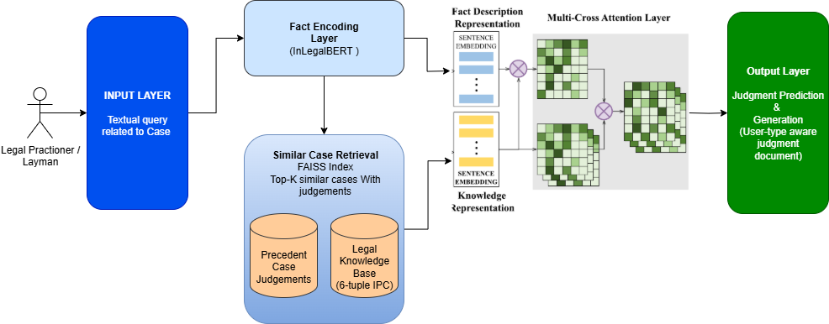
Attention-Based Legal Judgment Prediction – Architecture

Slide 5
Challenges
1) Data Scarcity and Quality: Limited availability of well-structured, annotated Indian legal datasets with clearly labeled charges, IPC sections, and outcomes makes effective model training and evaluation difficult.
2) Contextual Complexity of Legal Cases: Legal judgments often depend on subtle contextual details and interpretations, making it challenging for models to maintain accuracy across varying fact patterns and case types.
3) Precedent Relevance and Ranking: Accurately retrieving and ranking relevant precedent cases requires more than text similarity—legal logic, jurisdiction, and context must also be considered.
4) Explainability Constraints: While attention mechanisms provide some interpretability, generating legally meaningful and transparent justifications for predictions (e.g., cited precedents, applied laws) remains complex.
5) Legal Diversity and Jurisdictional Variability: Adapting the system to reflect differences in interpretation and application of laws across various Indian courts and states introduces consistency and scalability challenges.

Slide 6
References
[1] Y. Le, Z. Quan, J. Wang, D. Cao, and K. Li, “R²: A Novel Recall & Ranking Framework for Legal Judgment Prediction,” IEEE/ACM Transactions on Audio, Speech, and Language Processing, vol. 32, pp. 1609–1622, 2024, doi: 10.1109/TASLP.2024.3365389.
[2] N. A. Samee, M. Alabdulhafith, S. M. A. H. Shah, and A. Rizwan, “JusticeAI: A Large Language Models Inspired Collaborative and Cross-Domain Multimodal System for Automatic Judicial Rulings in Smart Courts,” IEEE Access, vol. 12, pp. 112956–112972, Nov. 2024, doi: 10.1109/ACCESS.2024.3491775.
[3] A. Fan, S. Wang, and Y. Wang, “Legal Document Similarity Matching Based on Ensemble Learning,” IEEE Access, vol. 12, pp. 22574–22585, Mar. 2024, doi: 10.1109/ACCESS.2024.3371262.
[4] Y. Al-Shareef, “CHRExpert: An AI-Driven Court of Human Rights Expert Assistant for Legal Practitioners Utilizing Transformer Models,” IEEE Access, vol. 13, pp. 26740–26750, Mar. 2025, doi: 10.1109/ACCESS.2025.3547763.
[5] P. Bhattacharya, A. Ghosh, P. Sengupta, and S. Ghosh, “A dataset for statutory reasoning in Indian law,” in Proceedings of the 60th Annual Meeting of the Association for Computational Linguistics (Volume 1: Long Papers), Dublin, Ireland, May 2022, pp. 5562–5575, doi: 10.18653/v1/2022.acl-long.381.

